Slide 1
Storing Data for Perpetuity? Use Linked Data
Australian Government Linked Data Working Group

Slide 2
What is linked data?

Slide 3
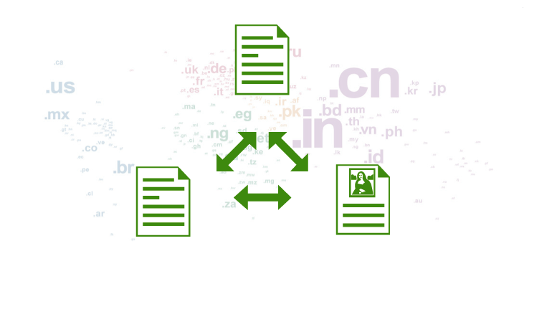
Traditional Web = Internet + Links + Docs

Slide 4
Is there a problem with that?
The Web was created to share data
We are interested in ‘THINGS’
These ‘THINGS’ might be in documents
We can read an HTML document in a browser and find what we are searching for
Hard for computers
Computers have to guess (Google does this very well)
Notes:
The guy who came up with the idea of the World Wide Web, Sir Tim Berners-Lee invented the Web under the premise that it will be used to share data. Usually we want to know something about things, like an actor, a place, a city, a painting.
However, this vision did not come to fruition immediately and the Web was mainly used to share and link documents.
We are quite used to finding information in documents.

Slide 5
What do we need to do?
Make it easy for computers/software to find ‘THINGS’

Slide 6
How can we do that?
Publish something that computers can understand!

Slide 7
RAW DATA!

Slide 8
… don’t we do that already on data.gov.au?

Slide 9
Current Raw Data
APIs
XML
CSV
XLS
…
Can’t computers and applications already consume that data?

Slide 10
Yes, but it is all in different formats and data models!

Slide 11
We have a standardised method of publishing documents on the Web!
HTML

Slide 12
We also have a standardised method of publishing and linking data.
Linked Data

Slide 13
Linked Data principles
Use URIs to name ‘THINGS’
Use URLs for those ‘THINGS’ whenever possible
Publish semantic information at this URL
Include links to other ‘THINGS’

Slide 14
1. – 2. Use real (live) URIs
Identifiers are required for ‘THINGS’
people, places, companies, products, government agencies, roads, hospitals, schools, events, natural resources, public infrastructure, etc. …
… all the things
… we have questions about
… and some of the answers

Slide 15
1. – 2. Use real (live) URIs
URI – Uniform Resource Identifier
Compact sequence of characters …
… identifies an abstract or physical resource
[RFC3986]
In Linked Data Web → URI = URL http://lab.environment.data.gov.au/id/acorn-system/Adelaide_023090_023000

Slide 16
1. – 2. Use real (live) URIs
Put information about these ‘THINGS’ on your website
Use good URLs
Readable, unambiguous … even in 10 years or ∞
http://agift.naa.gov.au/000478.htm →
http://data.naa.gov.au/def/agift/environment

Slide 17

3. Publish semantic information RDF
RDF – Resource Description Framework
Knowledge representation language for the Semantic Web
Allows to add structured information to Web resources
RDF as data model
Statements about Web resources in the form of triples
Subject – Predicate – Object
http://dbpedia.org/resource/Canberra http://dbpedia.org/property/elevation 577
“Canberra”
“has elevation”
577m

Slide 18
3. Publish semantic information Ontologies
RDF triples use predicates to link …
Resources to resources
Resources to property values
… assign meaning through ontologies, i.e. an "explicit specification of a conceptualization” as defined by Tom Gruber
set of concepts (shared objects)
relationships between those concepts (shared predicates)
e.g. FOAF (Friend-of-a-Friend) ontology
Person Concept
Class
URI – e.g., http://xmlns.com/foaf/Agent
A perspective of the concept via attributes / properties: name, age, gender, …

Slide 19
4. Include links
http://education.data.gov.au/ id/school/2060
http://dbpedia.org/resource/ Canberra_Grammar_School
owl:sameAs

Slide 20
Why linked data for DATA.GOV.AU?
20
Notes:
20

Slide 21
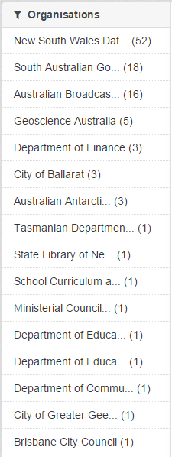
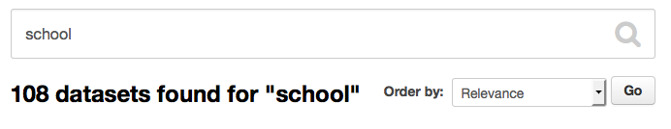
108 datasets
14 organisations + 2 external data portals
3 levels of government
1 concept

Slide 22
Use URIs to identify Government resources (THINGS)
Government agencies already keep a list of identifiers for each type of ‘THING’ they are responsible for (schools, roads, etc.)
Use identifiers to make statements about ‘THINGS’
e.g. ‘ACT school location dataset’
uses 2060 as identifier for ‘Canberra Grammar School’ (coinciding with postcode)

Slide 23


Why do we need guidelines for URIs
URIs are cool if they are:
Readable
http://example.com/000478.htm → http://example.com/def/agift/environment
Unambiguous
http://example.com/newcastle → http://example.com/australia/nsw/newcastle
Include no implementation details
http://example.com/index.php?type=university&id=136 → http://example.com/id/australian-national-university
Maintained! → even if content moves (or is deleted), server should respond appropriately
… and broken links are very uncool

Slide 24
What types of URIs do we need?
Index of a Dataset: Identifier that names a Linked dataset and provides metadata of the dataset.
Real-world ‘Things’ Identifier: Physical and abstract ‘Things’ that may be referred to in statements.
Document Identifier: Information on the web about Real World ‘Things’
Vocabulary identifiers (ontologies, concepts etc.): URIs for classes and properties describing real-world things

Slide 25
Proposed URI patterns
Index of a Dataset: Identifier that names a Linked dataset and provides metadata of the dataset.
Real-world ‘Things’ Identifier: Physical and abstract ‘Things’ that may be referred to in statements.
Document Identifier: Information on the web about Real World ‘Things’
Vocabulary identifiers (ontologies, concepts etc.): URIs for classes and properties describing real-world things
/dataset[/{module}]*/{datasetid} → /dataset/act/schools [Metadata for School Dataset]
/id/{type}/{name} → /id/school/2060 [Canberra Grammar]
/doc/{type}/{name} → /doc/school/2060 [Document about Canberra Grammar]
/def/{scheme}/{concept} → /def/school/phaseOfEducation [Class definition]

Slide 26
AGIFT as Linked Data

Slide 27
Australian Governments’ Interactive Functions Thesaurus (AGIFT)
Three-level hierarchical thesaurus
Describes business functions of Commonwealth, state and local governments in Australia
Contains 25 high-level functions, each with second and third level terms + non-preferred/related terms.
Purpose: To aid online discovery of government information and services
Published (in HTML) at: http://agift.naa.gov.au/

Slide 28
AGIFT SKOS model
SKOS (Simple Knowledge Organization System) provides a model for expressing the basic structure and content of a thesaurus
Conceptual resources (concepts) identified through URIs
Labeled with lexical strings
Documented with various types of notes
Semantically related to each other in informal hierarchies and association networks
Aggregated into concept schemes
Computational Linguists &
Data Scientists
Text Mining & Data Analytics
Taxonomies & Classification Systems
Schemas & Ontologies
SKOS
Librarians & Taxonomists
Data Engineers &
Ontologists
Notes:
SKOS is at the intersection of three disciplines and their paradigms

Slide 29
AGIFT SKOS concepts
skos:Concept is used to describe the conceptual structure of a thesaurus by asserting that a given resource is a concept
Create a Uniform Resource Identifier (URI)
Asserting that the resource identified by this URI is of type skos:Concept
<http://data.gov.au/def/agift/prices-surveillance> a skos:Concept
AGIFT SKOS includes 584 such concepts which are organised into the <http://data.gov.au/def/agift> SKOS concept scheme through the assertion:
agift:prices-surveillance skos:inScheme <http://data.gov.au/def/agift>
25 concepts are top level terms in AGIFT which are referenced from this concept scheme via the skos:hasTopConcept relation
<http://data.gov.au/def/agift> skos:hasTopConcept agift:environment

Slide 30
AGIFT SKOS hierarchical relations
SKOS relation skos:broader is used to define the hierarchical relationships between Level 2/3 terms in AGIFT
agift:prices-surveillance skos:broader agift:fair-trading-compliance
skos:broader relation in the SKOS model is a transitive property, which means that …
agift:prices-surveillance skos:broader agift:fair-trading-compliance
agift:fair-trading-compliance skos:broader agift:business-support-and-regulation
… entail that
agift:prices-surveillance skos:broaderTransitive agift:business-support-and-regulation
Notes:
asserts a direct hierarchical link between the Level 2 concept “Fair Trading Compliance” and the Level 3 concept “Prices Surveillance”
also entails that “Prices Surveillance” is a narrower concept to “Fair Trading Compliance”

Slide 31
AGIFT SKOS associative relations
AGIFT includes a “SEE ALSO” section in the scope notes of a term that informally point the user to other, non-hierarchically related terms in AGIFT.
SKOS offers an associative relation (skos:related) to define such non-hierarchical relationships between terms.
skos:related relation is a symmetric property, meaning that the following assertion …
agift:agricultural-industry skos:related agift:agricultural-sciences
… entails
agift:agricultural-sciences skos:related agift:agricultural-industry

Slide 32
AGIFT SKOS metadata
SKOS provides some basic relationships for associating lexical labels with resources of any type
Label that identifies a term in AGIFT is associated with a SKOS concept via the skos:prefLabel relation.
“Non-preferred Terms” in AGFIT that denote other names the term is known for are associated with a concept with the skos:altLabel relation.
AGIFT scopes notes are associated with a concept with the skos:definition relation.

Slide 33
Linking AGIFT SKOS to other thesauri
COFOG, the Classification of the Functions of Government (administered by the UN Statistics Division), classifies government expenditure data by the purpose for which the funds are used.
COFOG includes 10 “functional” groups of expenditures (e.g. Defence, Education and Social Protection), while 2nd-level terms in COFOG are further split into up to 9 sub-groups.
SKOS mappings skos:broadMatch and skos:relatedMatch are used to state mapping (alignment) links between SKOS concepts in AGIFT and COFOG, e.g.
<agift:agricultural-industry> skos:relatedMatch <http://unstats.un.org/unsd/cr/references/cofog/version1/04-2-1>
Notes:
Developed by the OECD
Although slightly different in its purpose to AGIFT, there are some overlapping functions defined in COFOG and AGIFT
As none of the concepts defined in COFOG are an exact or close match to concepts defined in AGIFT,

Slide 34
How is this USEFUL?

Slide 35
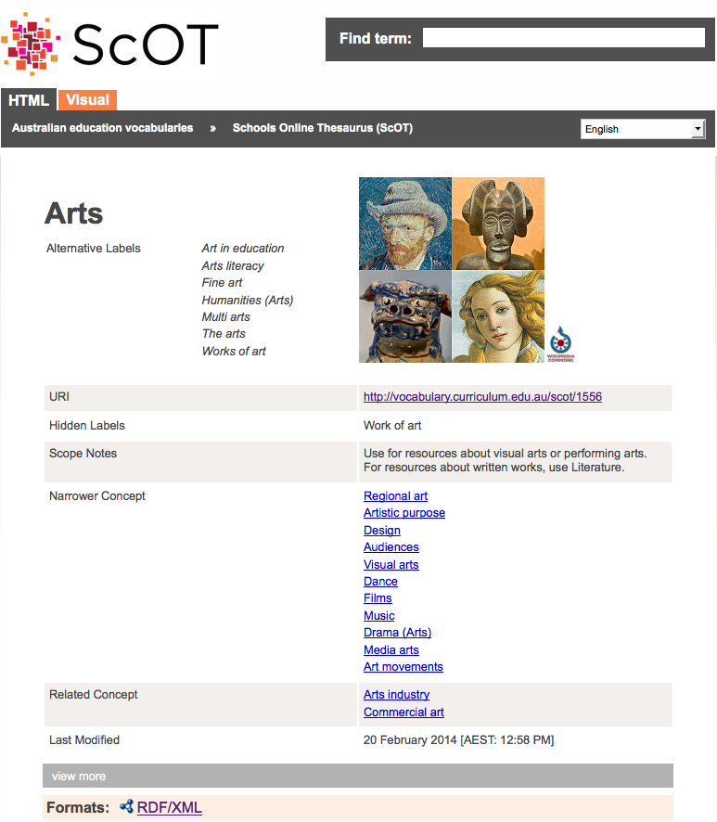
AGIFT SKOS for visualization/browsing
Australian Education Vocabularies
Schools Online Thesaurus (ScOT)

Slide 36
AGIFT SKOS used for information integration
Interlinked and integrated view on Government Data
AGIFT SKOS
SKOS AGIFT based graphs
SKOS AGIFT based graphs annotated with links to ontologies
Tree of Categories & terms
Annotating & categorising documents with AGIFT SKOS
Schemas, classes, properties, restrictions & rules in ontologies

Slide 37
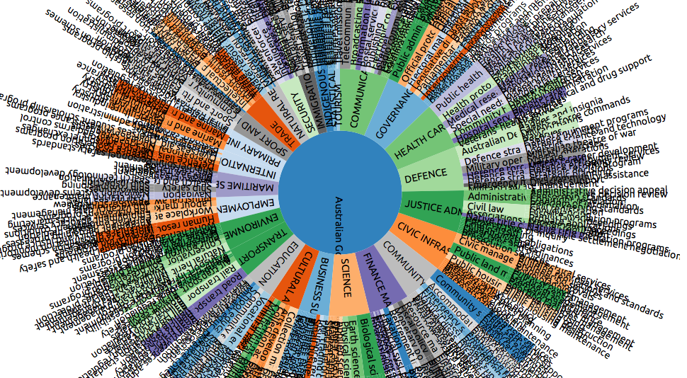
Questions?

